Slide 1
What is “AI”?
More specifically, how do Large Language Models work?

Slide 2
Conflict of interest
This is not my area of speciality
I have built my own “home-brew” AI but as a toy
It’s called Jeeves and it’s not allowed to leave the basement
It is in my interest to convince you that AI is just statistics
It secures my job and inflates my ego

Slide 3
BOSS
(Excited)
We’ve gotta get in on this new tech. Tell me, what is AI?
EMPLOYEE
(Flat)
It’s machine learning.
BOSS
(Less excited)
I see. Tell me, what’s machine learning?
EMPLOYEE
(Flat)
It's data science.
BOSS
(Deflated)
I see. Tell me, what's data science?
EMPLOYEE
(Flat)
It's statistics.
BOSS (Angry)
Forget it.
(Pauses then perks up)
What do you know about the blockchain?

Slide 4
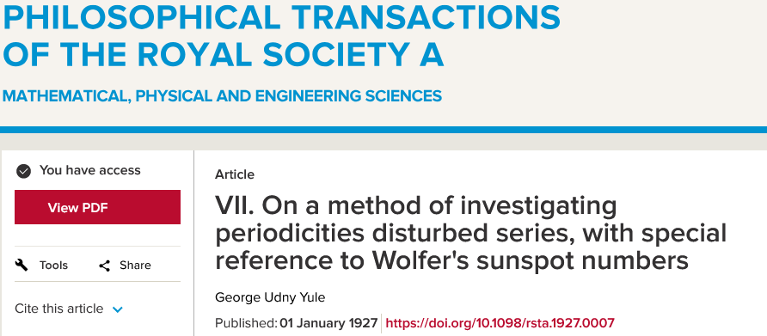
“Statistics is great and all, but it can’t do things like analyse time series”
Professor of Machine Learning Engineering (from a very prestigious university)

Slide 5
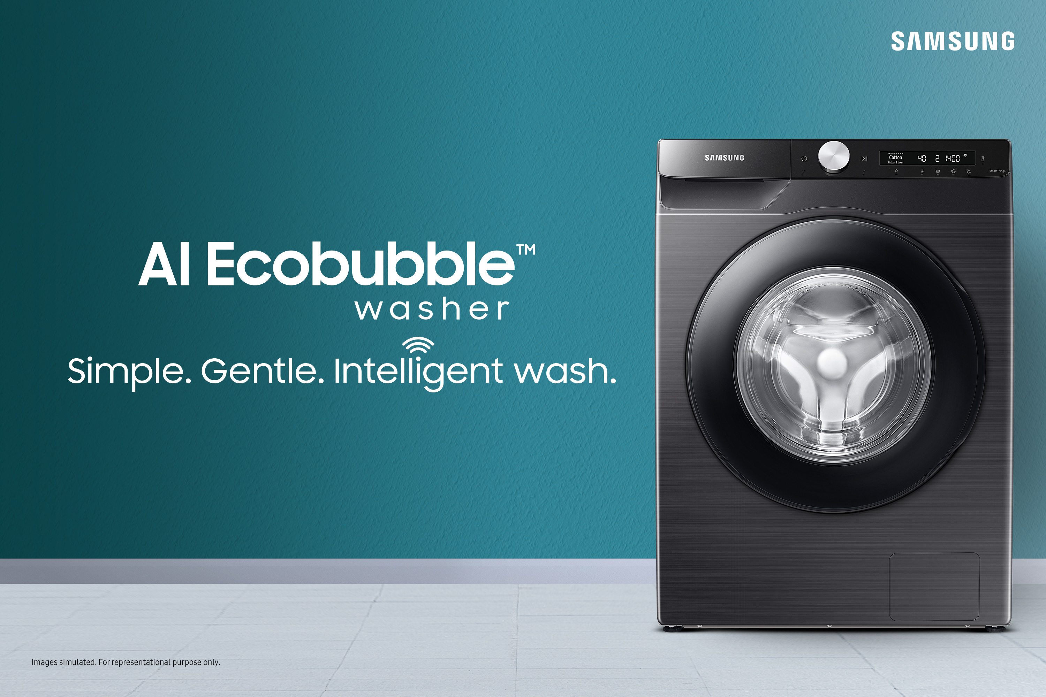
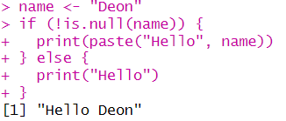
Artificial Intelligence
AI is largely a marketing term
Incredibly loose definition
Very often a GLM
But can mean a large language model
At times, it’s just clever conditional code
AI, or “genAI”, mostly taken to mean Large Language Models (LLMs)
ChatGPT, Claude, Co-Pilot, etc.
AI that produces text
Image generators (Diffusion models) similar but distinct
Midjourney etc.
AI that produces images (and videos)
Vagueness breeds misunderstanding

Slide 6
Vagueness breeds misunderstanding

Slide 7
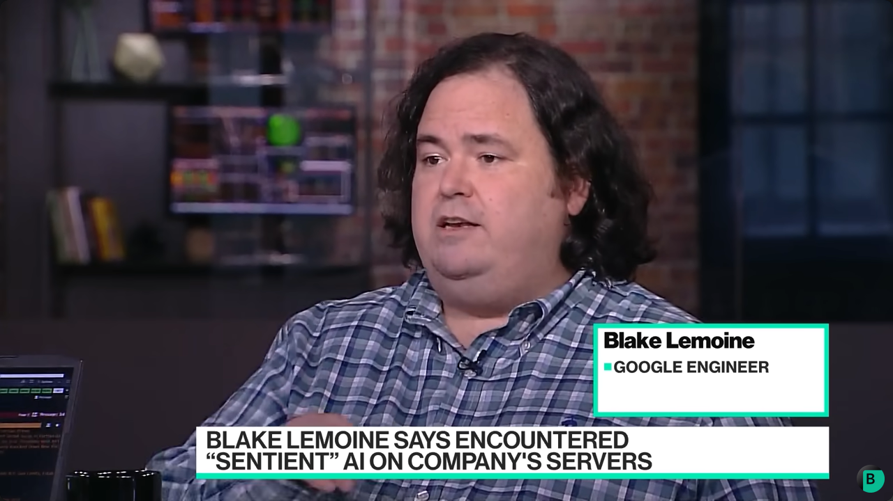
“AI is sentient”

Slide 8
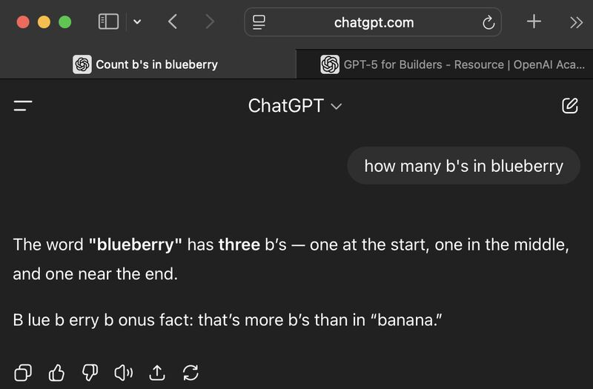
“LoL It’S So dUMB! It CAN’t do MAthS”

Slide 9
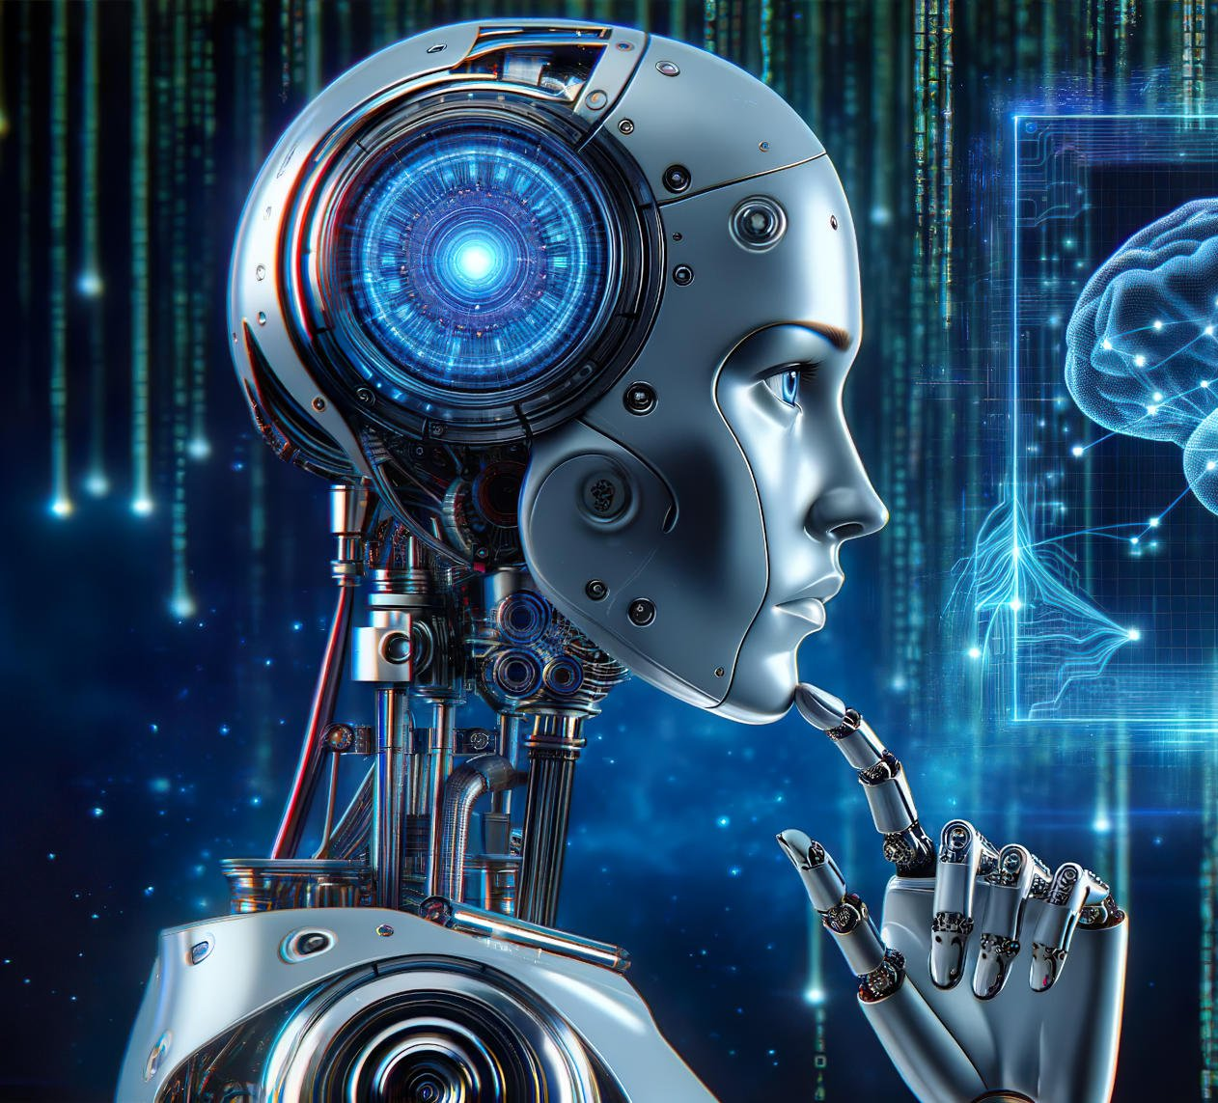
“AI is smarter than humans”

Slide 10
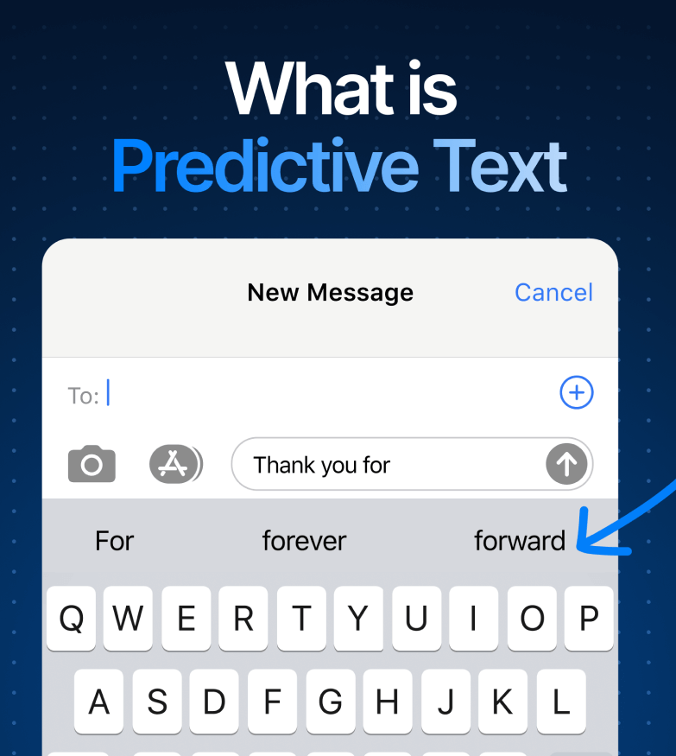
“AI is just a parrot”

Slide 11

“AI is objective and unbiassed”

Slide 12
So what is a large language model?
What follows is a crude summary explanation intended to give an intuitive understanding.
I’ll describe LLMs as having three “stages”
Tokenisation (akin to data processing)
Embedding (akin to multivariate analysis)
Transformer (akin to stacked GLMs)
Technically, this is then passed to a chatbot which you interact with.

Slide 13
Tokenisation
Relatively simple process
Takes text, separates it into words and splits them up into tokens
For example:
The seagull was seen stealing chips on Union Street as people cowered in fear
Becomes:
“The”, “ se”, “ag”, “ull”, “ was”, “ seen”, “ stealing”, “ chips”, “ on”, “ Union”, “ Street”, “ as”, “ people”, “ c”, “ower”, “ed”, “ in”, “ fear”

Slide 14
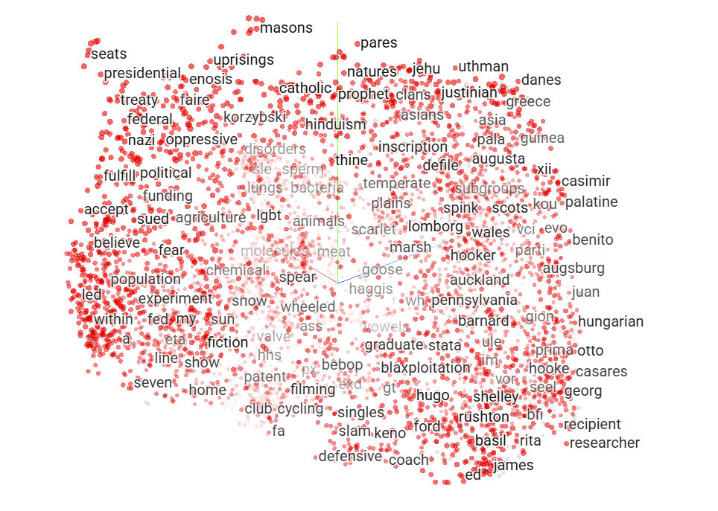
Embedding
Which are more similar?
“King” and “Queen”
“King” and “Chair”
Embedding converts tokens into a series of numbers that represents this “similarity” across all other tokens
Embedding values change depending on context
What if we added “Throne”?
If we see the token “King”, what other tokens are we most likely to see?
Embedding is where the model captures context
Queen
King
Throne
Chair

Slide 15
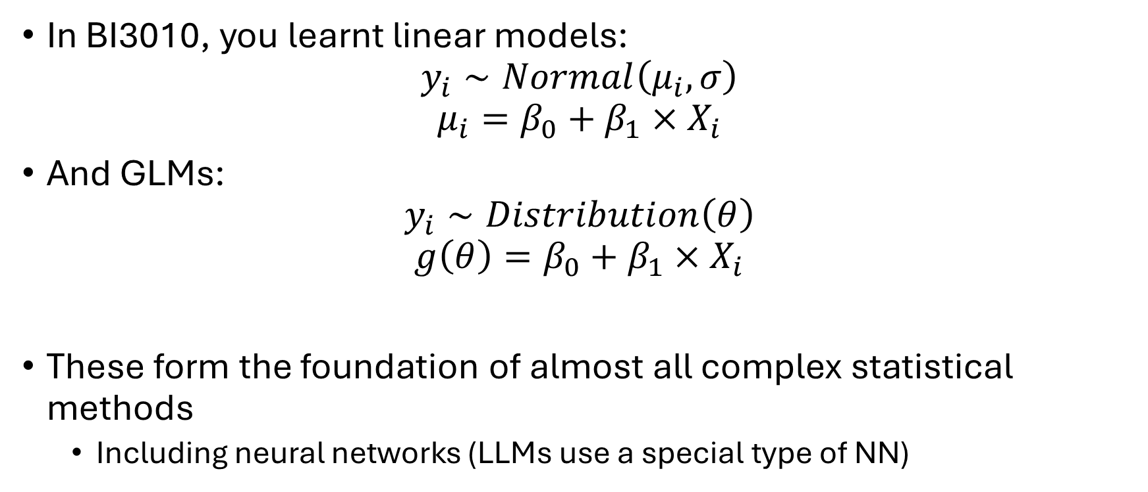
Neural networks
In BI3010, you learnt linear models:
$$y_{i}∼Normal\left(μ_{i},σ\right)$$
$$μ_{i}=β_{0}+β_{1}×X_{i}$$
And GLMs:
$$y_{i}∼Distribution\left(θ\right)$$
$$g\left(θ\right)=β_{0}+β_{1}×X_{i}$$
These form the foundation of almost all complex statistical methods
Including neural networks (LLMs use a special type of NN)

Slide 16
Where are people using NN outside of LMMs
Widely used
“Algorithms”
Medicine

Slide 17

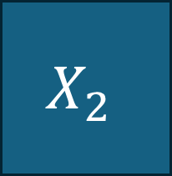
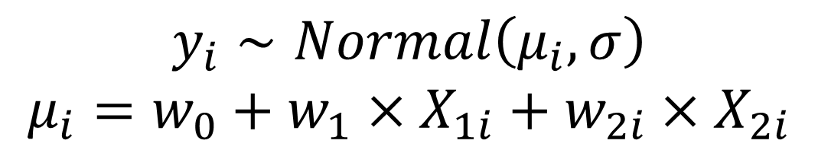




Linear model as a neural network
NN often doesn’t use a distribution (a.k.a. likelihood) as the metric to minimise
$$X_{1}$$
$$w_{1}$$
$$Y$$
$$X_{2}$$
Linear
$$w_{2}$$
$$y_{i}∼Normal\left(μ_{i},σ\right)$$
$$μ_{i}=w_{0}+w_{1}×X_{1i}+w_{2i}×X_{2i}$$
In LLM $X_{1}$, $X_{2}$ and $Y$ are embedding values

Slide 18
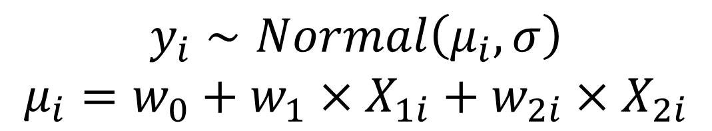

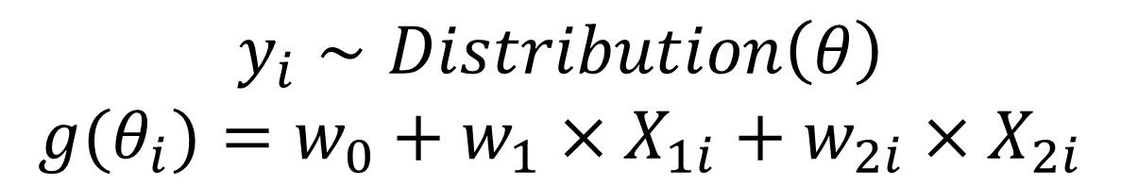



GLMs as a neural network
Link functions are called “Activation Functions” in machine learning
$$X_{1}$$
$$w_{1}$$
$$Y$$
Link function
$$X_{2}$$
Linear
$$w_{2}$$
$$y_{i}∼Distribution\left(θ\right)$$
$$g(θ_{i})=w_{0}+w_{1}×X_{1i}+w_{2i}×X_{2i}$$
$$y_{i}∼Normal\left(μ_{i},σ\right)$$
$$μ_{i}=w_{0}+w_{1}×X_{1i}+w_{2i}×X_{2i}$$

Slide 19







Neural networks tend to have multiple layers
$$X_{1}$$
$$w_{1}$$
$$Y$$
$$w_{4}$$
$$w_{2}$$
Link function
Link function
Link function
$$X_{2}$$
$$g\left(θ_{i}\right)=w_{0}+w_{1}×X_{1i}+w_{2i}×X_{2i}$$
$$g\left(ζ_{i}\right)=w_{3}+w_{4}×θ_{i}$$

Slide 20



And multiple neurons
$$X_{1}$$
Link function
$$Y$$
Link function
Link function
$$X_{2}$$
Link function
Link function

Slide 21
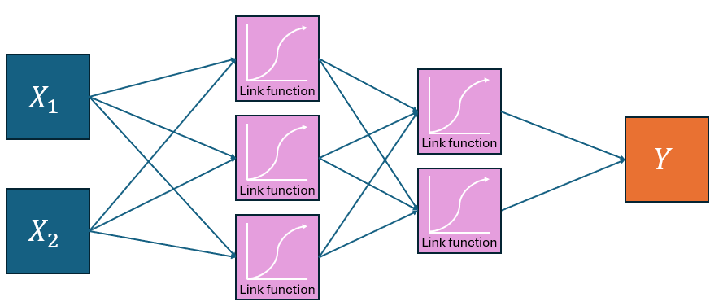
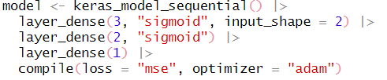
NN can be fit in R
Surprisingly easy to fit neural networks in R
mse is mean squared error. It’s using residual error just like your linear models!

Slide 22
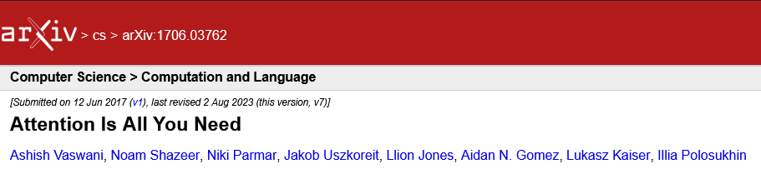
Transformers
Language models have been around since the 1940’s
E.g. n-gram models developed by Claude Shannon
Also include extensions/derivations like Structural Topic Models
Grace Sommerville is using STMs for their Honour’s project
Neural networks were a big advancement but:
Slow and inefficient, and bad at retaining information
Transformers are a type of a neural network model
Crucially, use “attention” to let each token relate to all others in a sequence
Much faster than previous versions of NN
Allow context-sensitive meanings, such as distinguishing “river bank” from “money bank”

Slide 23


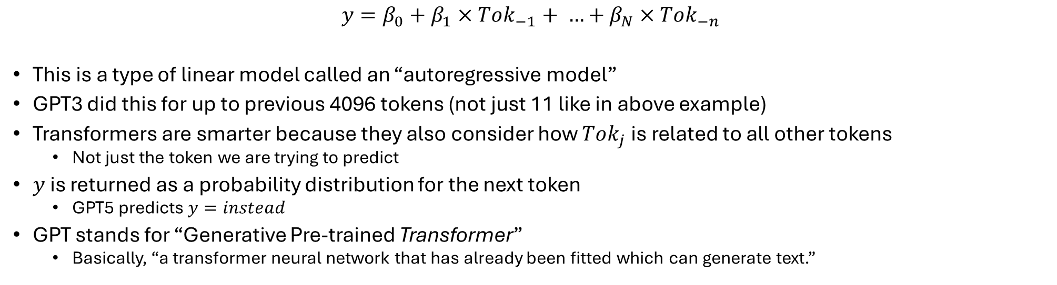


Here’s how transformers kind of work
lynx released today edinburgh locals fed whiskers cat food offer buckfast… $y$
$$Tok_{−11}$$
$$Tok_{−3}$$
$$Tok_{−2}$$
$$Tok_{−1}$$
What comes next?
$$y=β_{0}+β_{1}×Tok_{−1}+ …+β_{N}×Tok_{−n}$$
This is a type of linear model called an “autoregressive model”
GPT3 did this for up to previous 4096 tokens (not just 11 like in above example)
Transformers are smarter because they also consider how $Tok_{j}$ is related to all other tokens
Not just the token we are trying to predict
$y$ is returned as a probability distribution for the next token
GPT5 predicts $y=instead$
GPT stands for “Generative Pre-trained Transformer”
Basically, “a transformer neural network that has already been fitted which can generate text.”

Slide 24
NN use the same tricks you know
A NN is just a model with a collection of parameters that have to be estimated
Uses data to estimate parameter values
Specifically, uses residual error to estimate parameters
Uses optimisers to do the estimation
Generally, one called Gradient Descent (often Adam or variants specifically)
The “learning” in Machine Learning and “intelligence” in AI is what you’ve been doing this entire course
It’s just estimating parameters from data

Slide 25
And lots of tricks you don’t know
Multi-head attention
Allows the model look at tokens in multiple different ways at once
Feed forward networks
Allows each parameter to be re-estimated before passing on to next stage of model
Parameter scale
Current versions use billions of parameters (hence computational requirements)
Multiple data sources
Early models used text just from data, but new models now use data collected from users and from experts
And combine these within the model

Slide 26



Large Language Models
Convert words to tokens
Estimate embedding value to capture “similarity”
Use embeddings as explanatory and response variables
$$X_{1}$$
“The”, “ se”, “ag”, “ull”, “ was”, “ seen”,
$$Y$$
$$X_{2}$$

Slide 27
Output are predictions
Your prompt is essentially:
fake <- data.frame(prompt = “How do you calculate the mean in Rstudio??”)

Slide 28

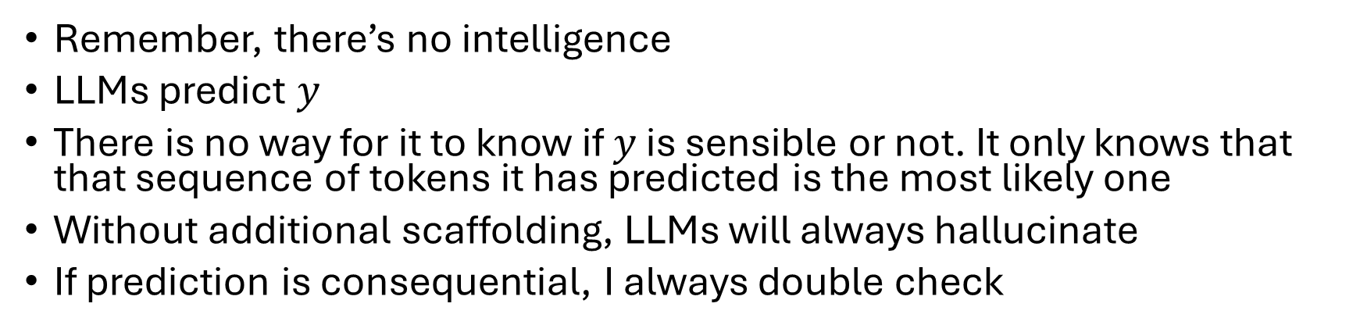


Why do LLMs hallucinate?
$$X_{1}$$
“The”, “ se”, “ag”, “ull”, “ was”, “ seen”,
$$Y$$
$$X_{2}$$
Remember, there’s no intelligence
LLMs predict $y$
There is no way for it to know if $y$ is sensible or not. It only knows that that sequence of tokens it has predicted is the most likely one
Without additional scaffolding, LLMs will always hallucinate
If prediction is consequential, I always double check

Slide 29
Examples of where they fail

Slide 30

Why are LLMs bad at maths?
$$X_{1}$$
“The”, “ se”, “ag”, “ull”, “ was”, “ seen”,
$$Y$$
$$X_{2}$$
These are language models
Expecting it to do maths is a failure of the user and the result of marketing
Some chatbots will now recognise maths questions, do the calculations in python and return the output
A crude but workable solution that obscures the limitation
ChatGPT does not do this by default unless the problem is complex or you request it
LLMs increasingly used as coordinator of other apps
python
Microsoft Bing
Calculators for simple calculations
Diffusion models for image generation

Slide 31
LLMs for coding
$$X_{1}$$
“The”, “ se”, “ag”, “ull”, “ was”, “ seen”,
$$Y$$
$$X_{2}$$
LLMs are great at predicting repetitive, consistent and logical language
I.e. programming languages
LLMs great for mundane and fiddly coding tasks
Used to be unreliable for more complex code but increasingly better
Not 100% though – lots of back and forth
Fundamentally, you need to know how the code should work
Theory and ideas now far more important than implementation

Slide 32
Prompt engineering
$$X_{1}$$
“The”, “ se”, “ag”, “ull”, “ was”, “ seen”,
$$Y$$
$$X_{2}$$
The less information rich your prompt, the less quality data the model has to predict from
Predictions become increasingly “average” and extremely generic
Richer context in your prompt usually helps, but it also depends on whether your prompt matches patterns the model has seen
Aim to guide the model towards the patterns it has likely seen before
So give it lots of context
“Write an essay about red deer overabundance” will produce an essay
But it will be extremely and painfully generic

Slide 33
Write report on habitat conservation for species
“Birds flittering in the trees”

Slide 34
Hidden assumptions
$$X_{1}$$
“The”, “ se”, “ag”, “ull”, “ was”, “ seen”,
$$Y$$
$$X_{2}$$
Early versions of LLMs performed poorly mostly (or at least in part) because their data was low quality
Companies just scraped text from the web
Assumption of validity and assumption of representativeness
Some of the “big” advancements have really been about improving the underlying data quality, not the modelling
E.g. “Which option do you prefer?” or employing PhDs to write questions and answers for topics

Slide 35
Caution of hype
$$X_{1}$$
“The”, “ se”, “ag”, “ull”, “ was”, “ seen”,
$$Y$$
$$X_{2}$$
Marketing teams now talk about AGI
Artificial General Intelligence
Given the fundamental structure, I don’t see how this is justified
But the companies no longer share code, so who knows?
Some interest in “Type 1” versus “Type 2” thinking but these are refinements not revolutions
Strikes me as the equivalent of string theory in physics
“We’re so close to cracking it, just give us 10 more years”

Slide 36
With a basic understanding…

Slide 37
“AI is sentient”
$$X_{1}$$
“The”, “ se”, “ag”, “ull”, “ was”, “ seen”,
$$Y$$
$$X_{2}$$

Slide 38
“LoL It’S So dUMB! It CAN’t do MAthS”
$$X_{1}$$
“The”, “ se”, “ag”, “ull”, “ was”, “ seen”,
$$Y$$
$$X_{2}$$

Slide 39
“AI is smarter than humans”
$$X_{1}$$
“The”, “ se”, “ag”, “ull”, “ was”, “ seen”,
$$Y$$
$$X_{2}$$

Slide 40
“AI is just a parrot”
$$X_{1}$$
“The”, “ se”, “ag”, “ull”, “ was”, “ seen”,
$$Y$$
$$X_{2}$$

Slide 41

“AI is objective and unbiassed”
$$X_{1}$$
“The”, “ se”, “ag”, “ull”, “ was”, “ seen”,
$$Y$$
$$X_{2}$$

Slide 42
Exposure to messaging
Where have they seen people raising concerns
Jobs/lives at risk
Where do you think this is heading towards?
Part of broader discussion and may want to “vent”
Who is using versus not / dichotomy
Who has used and noticed nonsense
Which tools would students use
What are they capable of? How to spot?

Slide 43
What to remember about LLMs
LLMs are statistical models of language, not intelligent beings
They predict the most likely next token, not “truth”
Their strength lies in scale and pattern recognition, not reasoning
Great for: drafting, summarising, routine writing and coding
Weak for: complex reasoning, novel ideas, statistics, facts
Responsible use: treat outputs the same as you would for any of your own models
LLMs are impressive tools. But they are neither magic nor sentient minds and are not a substitute for expertise. They remove implementation barriers. They do not remove the need for knowledge.

